Slide 1



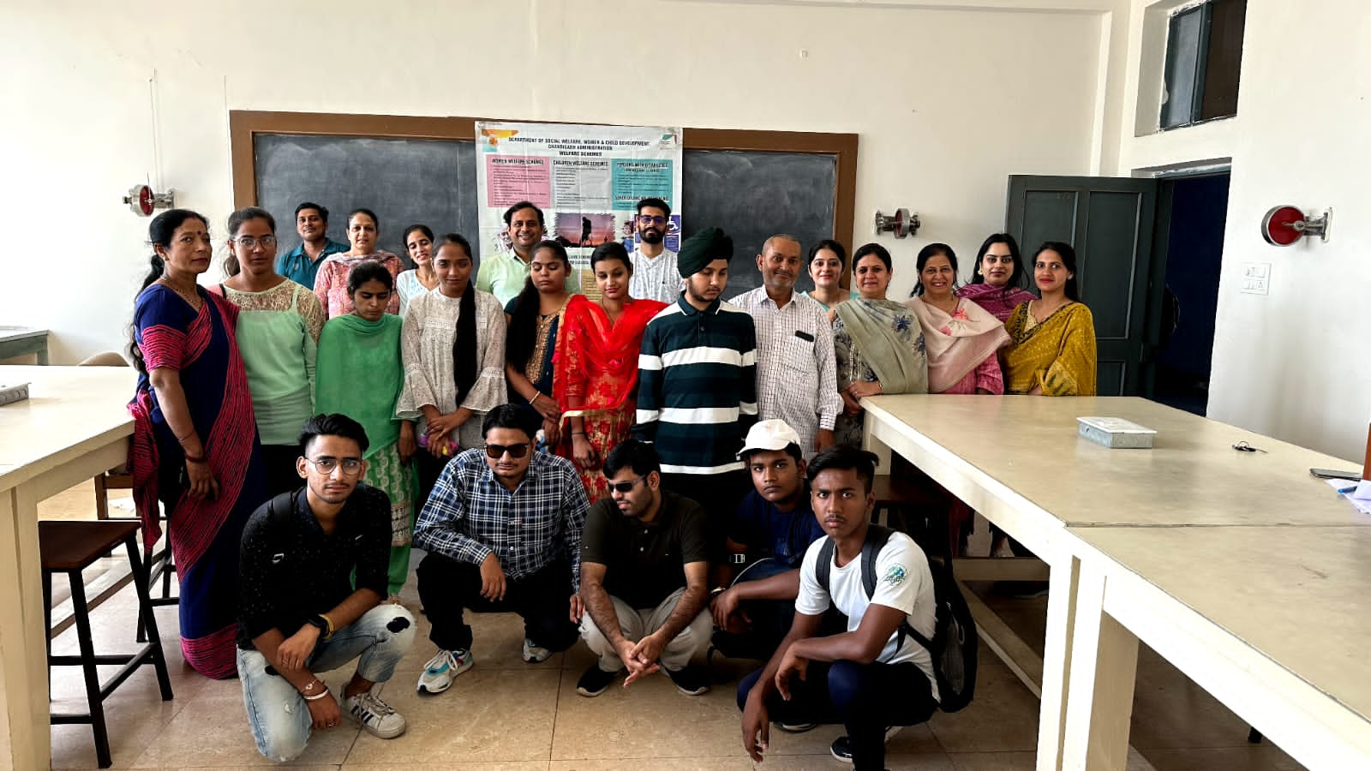
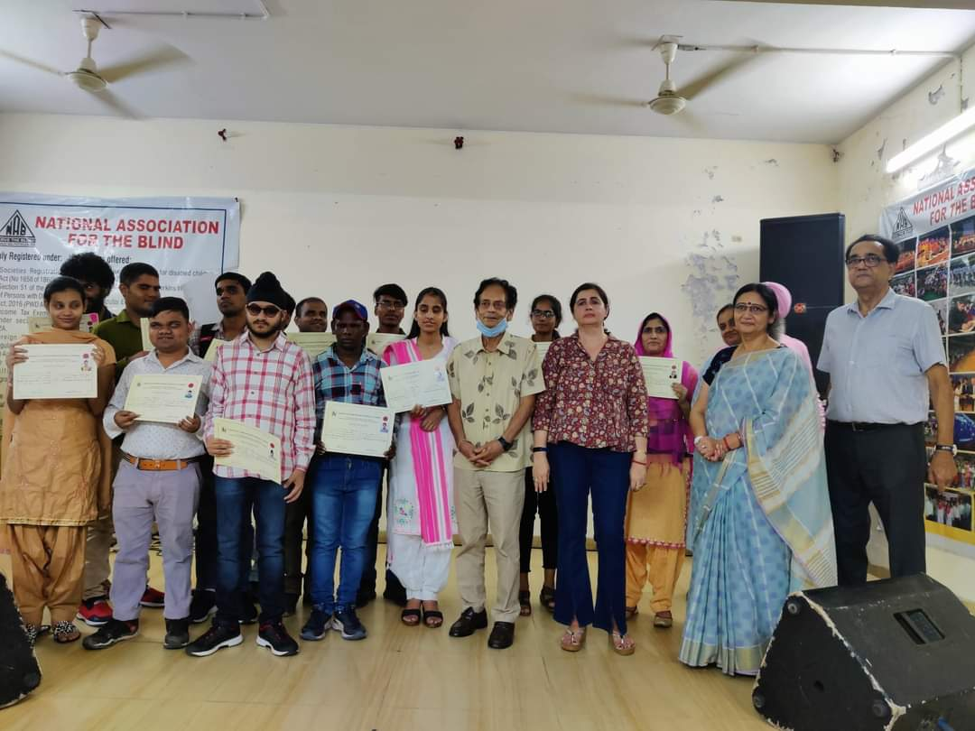
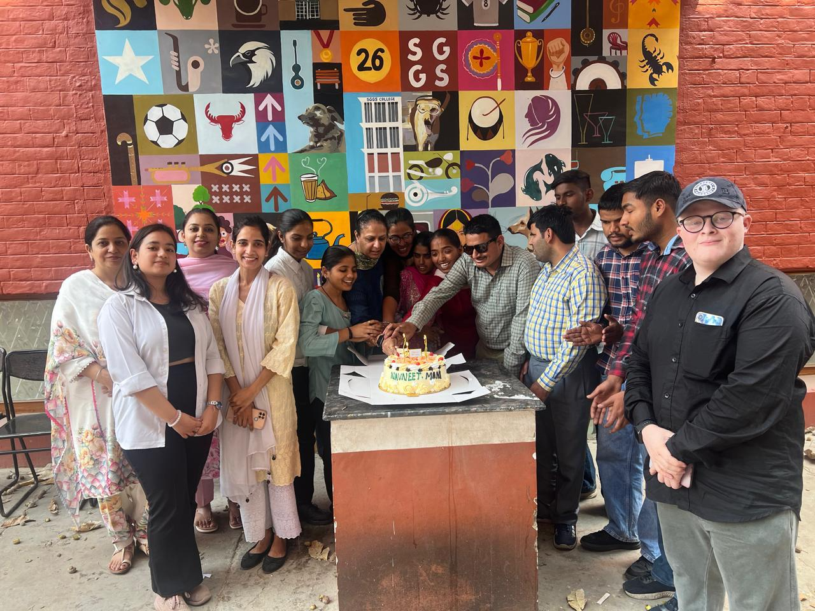
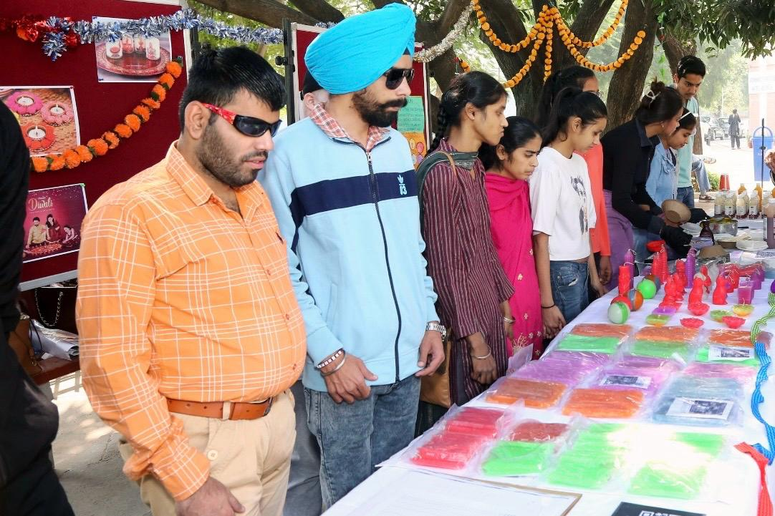
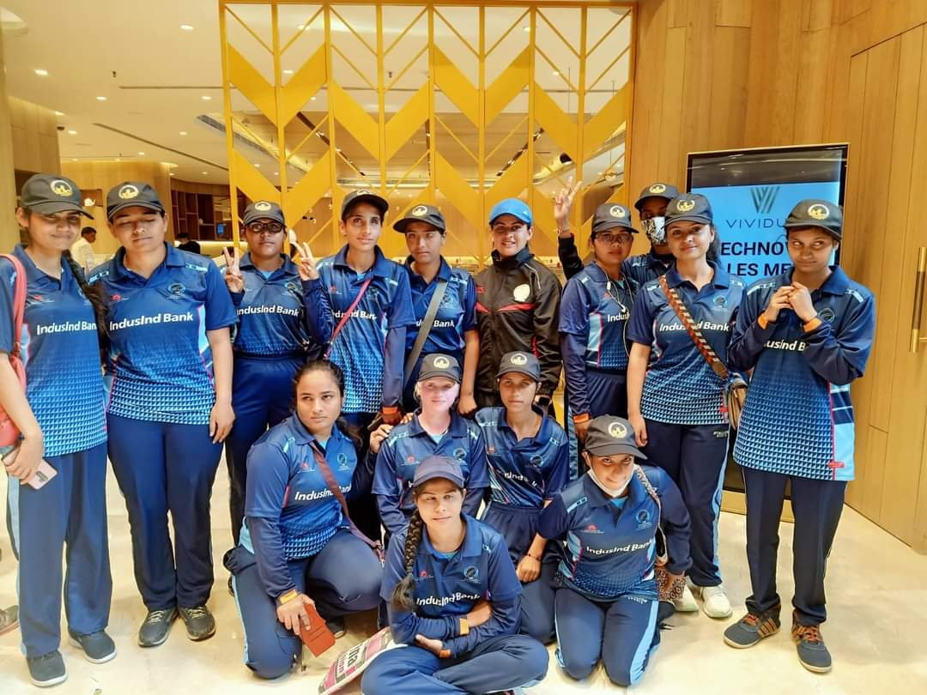
Sri Guru Gobind SiNgh College
SECTOR-26 CHANDIGARH
NAAC Re-Accredited Grade ‘A’
An Institution of the Sikh Educational Society
A Postgraduate Co-educational Institute affiliated to Panjab University, Chandigarh
ADMISSION OPEN
2026-27
Equal Opportunity Cell
“Manas ki jaat Sabhe Eke Pehchanbo”
(Recognise the entire human race as one)
The Equal Opportunity Cell embodies the College motto by ensuring accessibility, equity and holistic development of students from marginalised backgrounds specifically the Divyang students. The Cell is dedicated to create a campus where every voice is heard, every step is supported and every dream is within reach.
Join Us in Building an Inclusive Future!
Recognised as first inclusive and accessible Campus audited by Department of Empowerment of Persons with Disabilities, Ministry of Social Justice and Empowerment
Key Features
Inclusive Admission Policy
Highly Qualified Faculty
Scholarships and General Fee Concession for SC,ST,OBC and Divyang students
Free accommodation at Hostel (Boys)
Separate Hostel for Girl Students
Various UG courses under NEP 2020 and
14 PG courses
Various skill based Vocational and Certificate Courses
Preventing Discrimination
Grievance Redressal
Promoting Diversity
Full Fee Concession for
Meritorious Divyang Students
Student Support Services
Guidance & Mentorship
Remedial Classes
Cultural Participation
Participation in Sports
Assistive Exam Services
Counselling facility by well trained counsellors
Awareness Campaigns
MoU with the Institute for Blind,Sec-26, Chandigarh and collaboration with Government/non-government agencies
Infrastructure Facilities
Braille Signage
Braille Indicators
Helen Keller Braille Corner (College Library)
Tactile Paths
Ramps, Railings and
Wheelchair facility
Accessible Washrooms
Reserved Parking for PwD
Contact No: 0172-2792754
https://www.sggscollege.ac.in | Email: admission.sggs@gmail.com
Coordinator EOC: Dr Mani Pal Kaur Contact No: 7837305458
Dr Jaswinder Singh
Principal
Notes:
Sri Guru Gobind SiNgh College
SECTOR-26 CHANDIGARH
NAAC Re-Accredited Grade ‘A’
An Institution of the Sikh Educational Society
A Postgraduate Co-educational Institute affiliated to Panjab University, Chandigarh
Equal Opportunity Cell
The Equal Opportunity Cell embodies the College motto by ensuring accessibility, equity and holistic development of students from marginalized backgrounds specifically the Divyangjan. The Equal Opportunity Cell is dedicated to create a campus where every voice is heard, every step is supported and every dream is within reach.
Student Support Services
Guidance & Mentorship
Remedial Classes
Cultural Participation
Participation in Sports
Assistive Exam Services
Counselling
Awareness Campaigns
MoU with the Institute for Blind,Sec-26, Chd. and collaboration with Government/non-government agencies.
“Manas ki jaat Sabhe Eke Pehchanbo” (Mankind is One)
Key Features
Inclusive Admission Policy
Highly qualified faculty
Scholarships for SC,ST,OBC and Divangjan students
Various UG courses under NEP 2020 and 13 PG courses
Various skill based Vocational and Certificate Courses
Supportive Environment
Preventing Discrimination
Grievance Redressal
Promoting Diversity
Infrastructure Facilities
Our campus is designed to be
accessible and supportive:
Braille Books & Software
Braille Signboards
Braille Indicators
Helen Keller Braille Corner
Tactile Path
Ramps & Railings
Accessible Washrooms
Reserved Parking
Join Us in Building an Inclusive Future!
Total Freeship to
Meritorious Divyangjan Students
Contact No: 0172-2792754, 8437766329, 9815755859, 8556928121, 9592116722
https://www.sggscollege.ac.in | Email: admission.sggs@gmail.com
Dr Jaswinder Singh
Principal

